Slide 1
Recap lecture 19
NFA corresponding to Closure of FA, Examples, Memory required to recognize a language, Example, Distinguishing one string from another, Example, Theorem, Proof

Slide 2
Task
Consider the language L of strings of length three or more, defined over Σ = {0,1}, ending in 011 then determine which of the following pairs are distinguishable or indistinguishable w.r.t. L.
  001011, 11001111
  01001111, 1100001111

Slide 3
Solution of the Task
  It can be observed that taking z = ☹, 001011z belongs to L while 11001111z does not belong to L, which shows that 001011 and 11001111 are distinguishable w.r.t. L.
  It can be observed that both 01001111 and 1100001111 don’t belong to L. It can also be observed that for z  Σ* either both 01001111z and 1100001111z belong to L or both don’t. hence 01001111 and 1100001111 are indistinguishable w.r.t. L.

Slide 4
Example
Let L₂₀={w  {0,1}*: |w| ≥ 20 and the 20th letter of w, from right is, 1}. Let S be the set of all strings of length 20, defined over Σ, any two of which are distinguishable w.r.t. L₂₀. Obviously the number of strings belonging to S, is 2²⁰. Let x and y be any two distinct strings i.e. they differ in ith letter,i=1,2,3,…20, from left. For i=1, they differ by first letter from left.

Slide 5
Example continued …
Then by definition of L₂₀, one is in L₂₀ while other is not as shown below
So they are distinct w.r.t. L₂₀ for z = ☹ i.e. one of xz and yz belongs to L₂₀.
0
.
…
.
1
.
…
.

Slide 6
Example continued …
  Similarly if i=2 they differ by 2nd letter from left and are again distinguishable and hence for z belonging to Σ*, |z|=1, either xz or yz belongs to L₂₀ because in this case the 20th letter from the right of xz and yz is exactly the 2nd letter from left of x and y as shown below
.
0
…
z
.
.
1
…
.
z

Slide 7
Example continued …
Hence x and y will be distinguishable w.r.t. L₂₀ for i=2, as well. Continuing the process it can be shown that any pair of strings x and y belonging to S, will be distinguishable w.r.t. L₂₀. Since S contains 2²⁰ strings, any two of which are distinguishable w.r.t. L₂₀, so using the theorem any FA accepting L₂₀ must have at least 2²⁰ states.

Slide 8
Note
It may be observed from the above example that using Martin’s method, there exists an FA having 2²⁰⁺¹-1=2,097,151 states. This indicates the memory required to recognize L₂₀ will be the memory of a computer that can accommodate 21-bits i.e.the computer can be in 2²¹ possible states.

Slide 9
Finite Automaton with output
Finite automaton discussed so far, is just associated with the RE or the language.
There is a question whether does there exist an FA which generates an output string corresponding to each input string ? The answer is yes. Such machines are called machines with output.
There are two types of machines with output. Moore machine and Mealy machine

Slide 10
Moore machine
A Moore machine consists of the following
  A finite set of states q₀, q₁, q₂, … where q₀ is the initial state.
  An alphabet of letters Σ = {a,b,c,…} from which the input strings are formed.
  An alphabet Σ ={x,y,z,…} of output characters from which output strings are generated.

Slide 11
Moore machine continued …
4. A transition table that shows for each state and each input letter what state is entered the next.
5. An output table that shows what character is printed by each state as it is entered.

Slide 12
Moore machine continued …
Note: It is to be noted that since in Moore machine no state is designated to be a final state, so there is no question of accepting any language by Moore machine. However in some cases the relation between an input string and the corresponding output string may be identified by the Moore machine. Moreover, the state to be initial is not important as if the machine is used several times and is restarted after some time, the machine will be started from the state where it was left off. Following are the examples

Slide 13
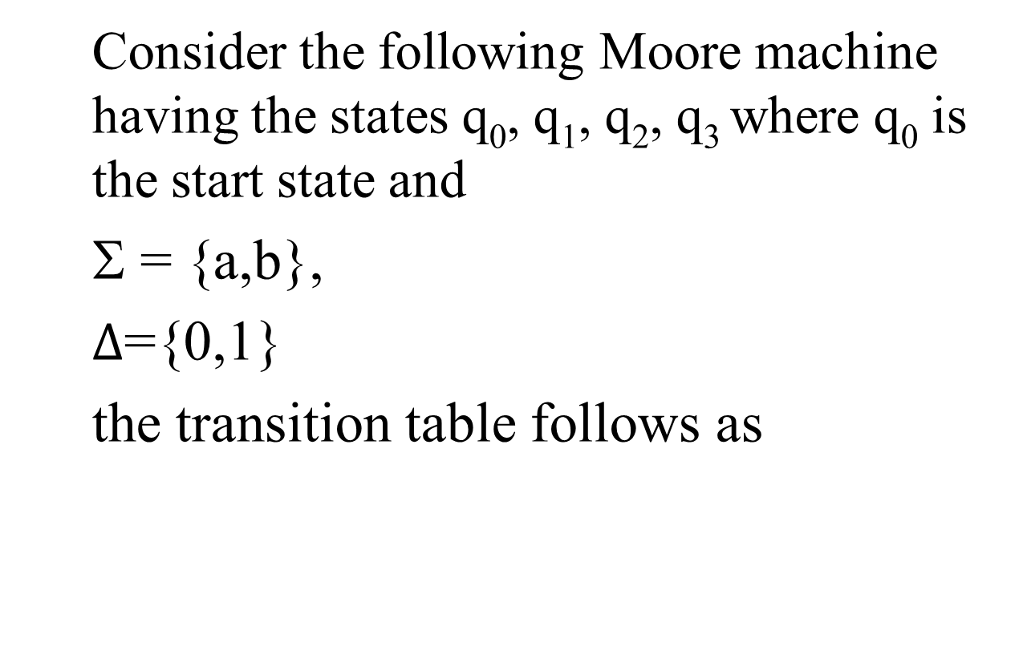
Example

Slide 14
Example continued …
Old States | New States after reading
 | a | b
q₀- | q₁ | q₃
q₁ | q₃ | q₁
q₂ | q₀ | q₃
q₃ | q₃ | q₂
Characters to be printed
1
0
0
1

Slide 15
Example continued …
the transition diagram corresponding to the previous transition table may be
b
q₀/1
a
q₁/0
b
a
a
b
q₂/0
q₃/1
a
b

Slide 16
Example continued …
b
It is to be noted that the states are labeled along with the characters to be printed. Running the string abbabbba over the above machine, the corresponding output string will be 100010101, which can be determined by the following table as well
q₀/1
a
q₁/0
b
a
a
b
q₂/0
q₃/1
a
b

Slide 17
Example continued …
It may be noted that the length of output string is l more than that of input string as the initial state prints out the extra character 1, before the input string is read.
Input
a
b
b
a
b
b
b
a
State
q₀
q₁
q₁
q₁
q₃
q₂
q₃
q₂
q₀
output
1
0
0
0
1
0
1
0
1

Slide 18
Summing Up
Recap Theorem, Example, Finite Automaton with output, Moore machine, Examples

